Slide 1
Rail Fence Cipher Utility
Pitch Deck
20xx
$
} /> [
Sara Hossam 254470
Renad Amr 253592
Reham Ahmed 254142
Course instructor: Dr. Nermin Kamal

Slide 2
$ What is This Project?
It is a classical encryption method that is easy to understand and useful for learning basic encryption concepts.
It is used to hide a message by rearranging its letters in a zigzag pattern.
The encrypted message is formed by reading the letters row by row.
The number of zigzag rows is determined by a numeric chosen key.

Slide 3

$ What is the purpose of the project?
To understand how encryption works
To apply theory using assembly language
To practice writing real programs in MIPS
.main

Slide 4
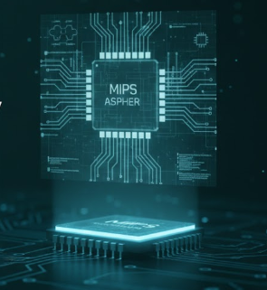
$ System & Tools
Architecture: MIPS
Language: MIPS Assembly
Simulator: QTSPIM
Input: Keyboard
Output: Console screen

Slide 5
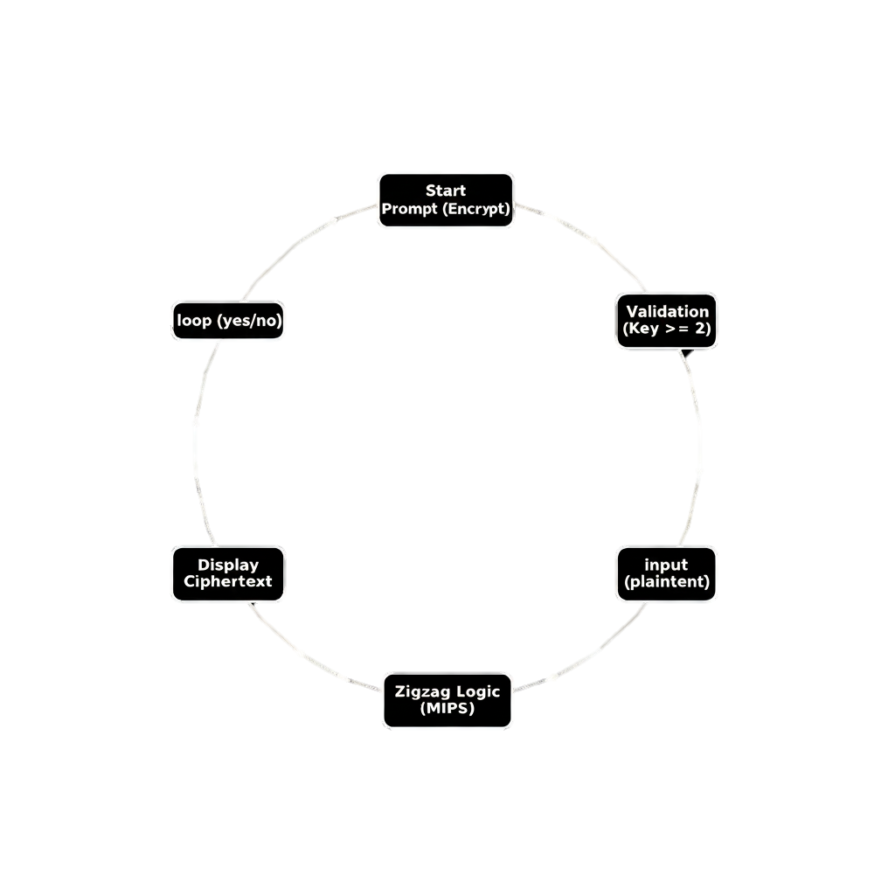
$ How Does the Program works?

Slide 6
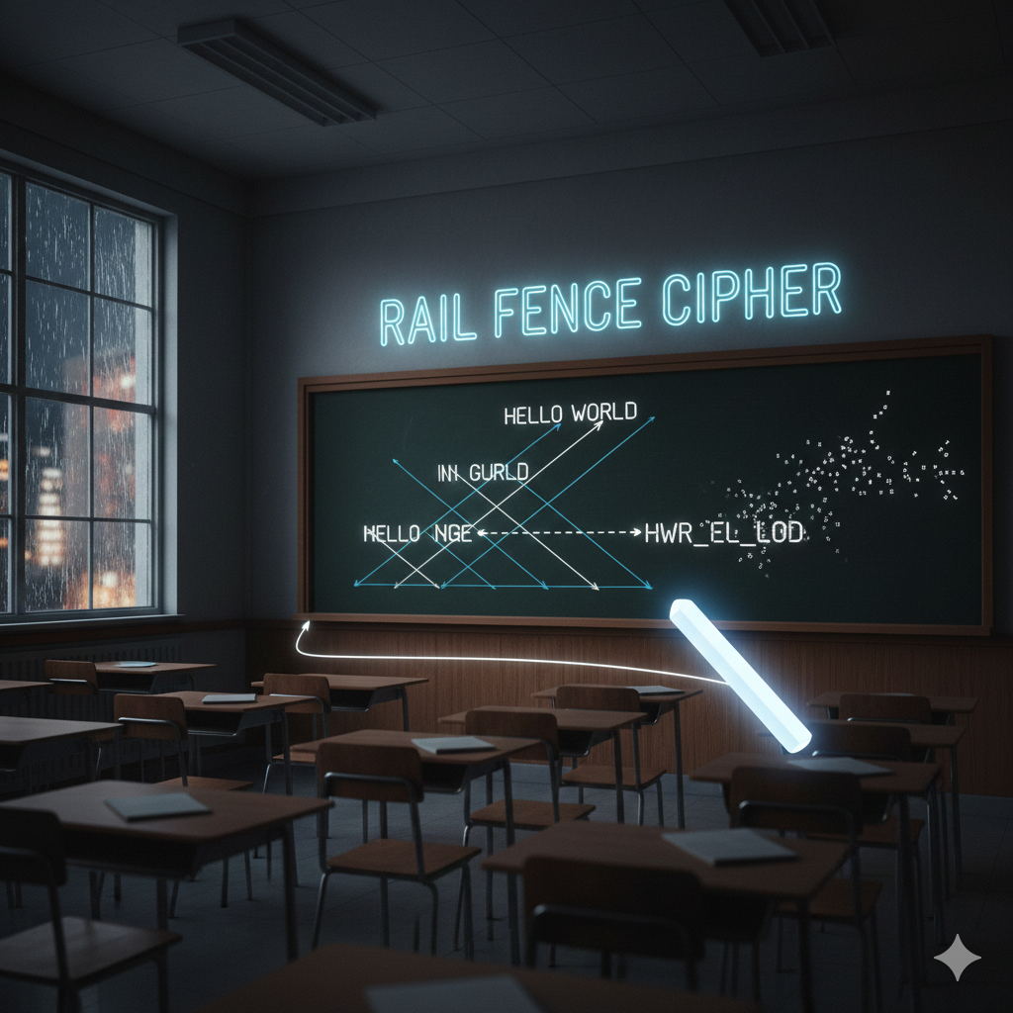
$ Example
Message: HELLO WORLD
Key: 3
Encrypted text: HOREL LWDLO

Slide 7
$ Program Behavior
Program runs in a loop.
User can encrypt multiple messages.
User exits when finished.
Input is validated.
Encrypted message is displayed immediately.

Slide 8
$ challenges
Implementing the zigzag (Rail Fence) cipher error-free.
Efficient management of memory and registers.
Robust handling of different user input cases.
$t0

Slide 9

$ limitation of rail fence
Rail Fence cipher is not secure
Easy to break
Not suitable for real encryption
Depends only on rearranging letters

Slide 10
$ Learning Outcomes
Understand encryption logic.
Improve problem-solving skills.
Practice assembly programming.
Improves understanding of computer organization.

Slide 11
Pitch Deck
20xx
$
Thanks!
SYSCALL

